Slide 1


E-commerce Customer Analysis
Exploring Data Insights and Predictive Modeling Using Python
by Mohamed Tharwat

Slide 2
Introduction:
Purpose:
Analyze e-commerce customer data and predict yearly spending.
Importance:
Provides actionable insights for optimizing customer experience and revenue.
Dataset Summary:
Includes demographics, behavioral metrics, and target variable.

Slide 3
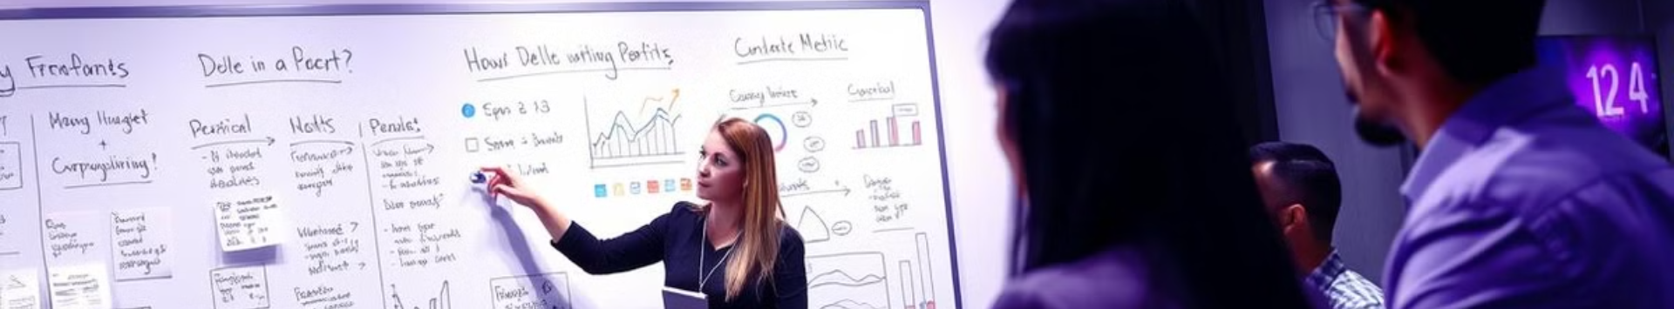
Project Workflow:
Data Loading and Initial Exploration
Exploratory Data Analysis (EDA)
Data Preparation and Feature Selection
Model Training (Linear Regression, KNN)
Model Evaluation and Residual Analysis

Slide 4

Exploratory Data Analysis (EDA)
Time on Website vs. Yearly Amount Spent: Weak correlation.
Time on App vs. Yearly Amount Spent: Moderate positive correlation.
Strongest correlation: Length of Membership and Yearly Amount Spent.
Boxplots detect potential outliers in Yearly Amount Spent.

Slide 5




Feature Selection and Model Training
Features (X):
Target (y):
Split data into training (70%) and testing (30%).
Avg. Session Length, Time on App, Time on Website, Length of Membership.
Yearly Amount Spent.
Trained two models: Linear Regression and KNN.

Slide 6
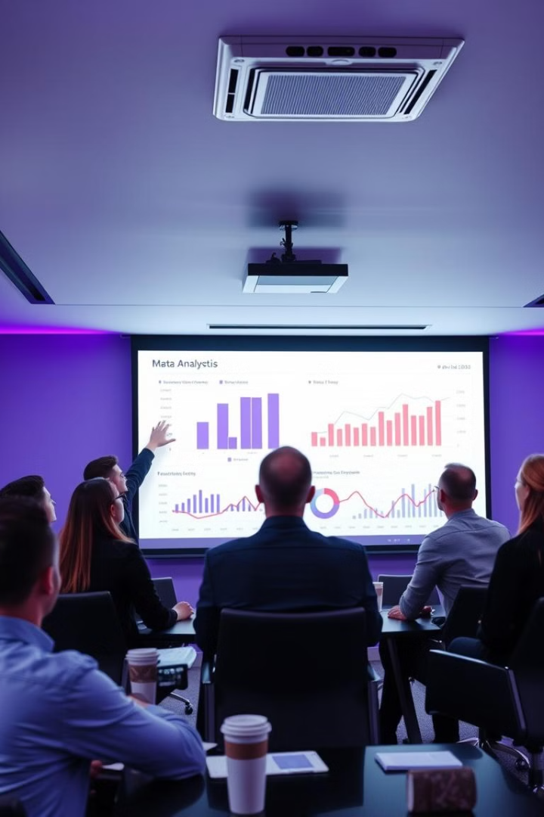
Linear Regression Model
1
Captures overall trends in the data
2
Coefficients: Measure the importance of each feature.
3
Evaluation Metrics:
Mean Absolute Error (MAE)
Mean Squared Error (MSE)
R² Score

Slide 7
KNN Regression Model
1
Utilizes k=5 neighbors for predictions.
2
Captures local patterns in the data.
3
Evaluation Metrics:
Mean Absolute Error (MAE)
Mean Squared Error (MSE)
R² Score

Slide 8
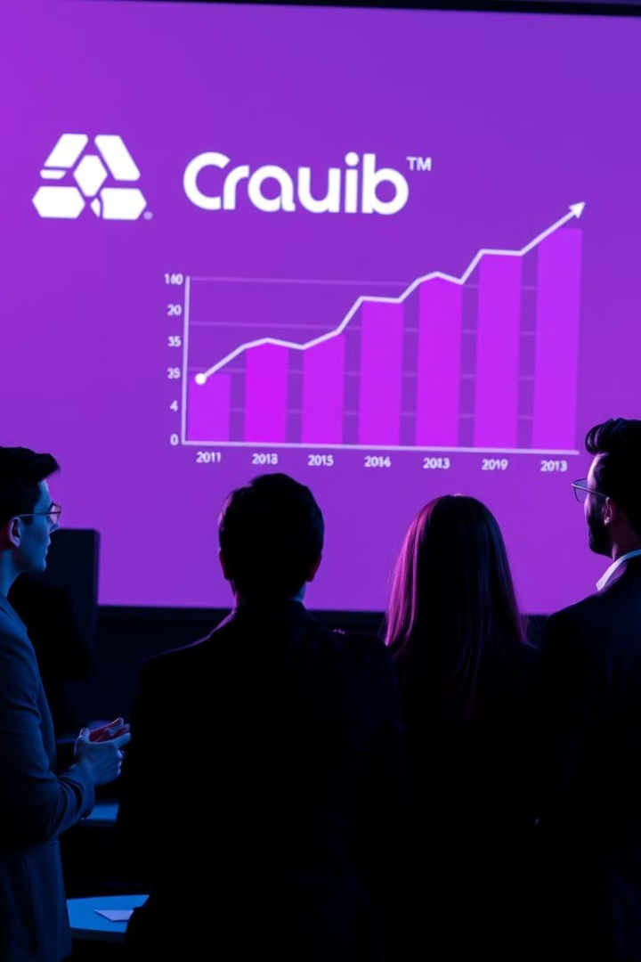
Model Comparison
Metric | Linear Regression | KNN Regression
MAE | 19.848088113558102 | 19.848088113558102
MSE | 618.0918058307074 | 618.0918058307074
R² | 0.9842664245050591 | 0.9072106048219022
Linear Regression explains trends better.
KNN captures local variations but may overfit.

Slide 9

Challenges and Improvements
1
2
3
Handling outliers for more robust predictions.
Exploring additional features and their interactions.
Hyperparameter tuning for KNN and testing alternative models.

Slide 10
Conclusion and Next Steps
Data Analysis:
1
Successfully analyzed e-commerce customer data to uncover key behavioral insights.
Modeling Results:
2
Built predictive models (Linear Regression and KNN) to forecast yearly spending, with Linear Regression showing better performance overall.
Business Insights:
3
Identified actionable insights, such as focusing on app engagement and membership duration, to enhance customer spending and retention.

